Slide 1
Team Bravo
Mad Matrix

Slide 2
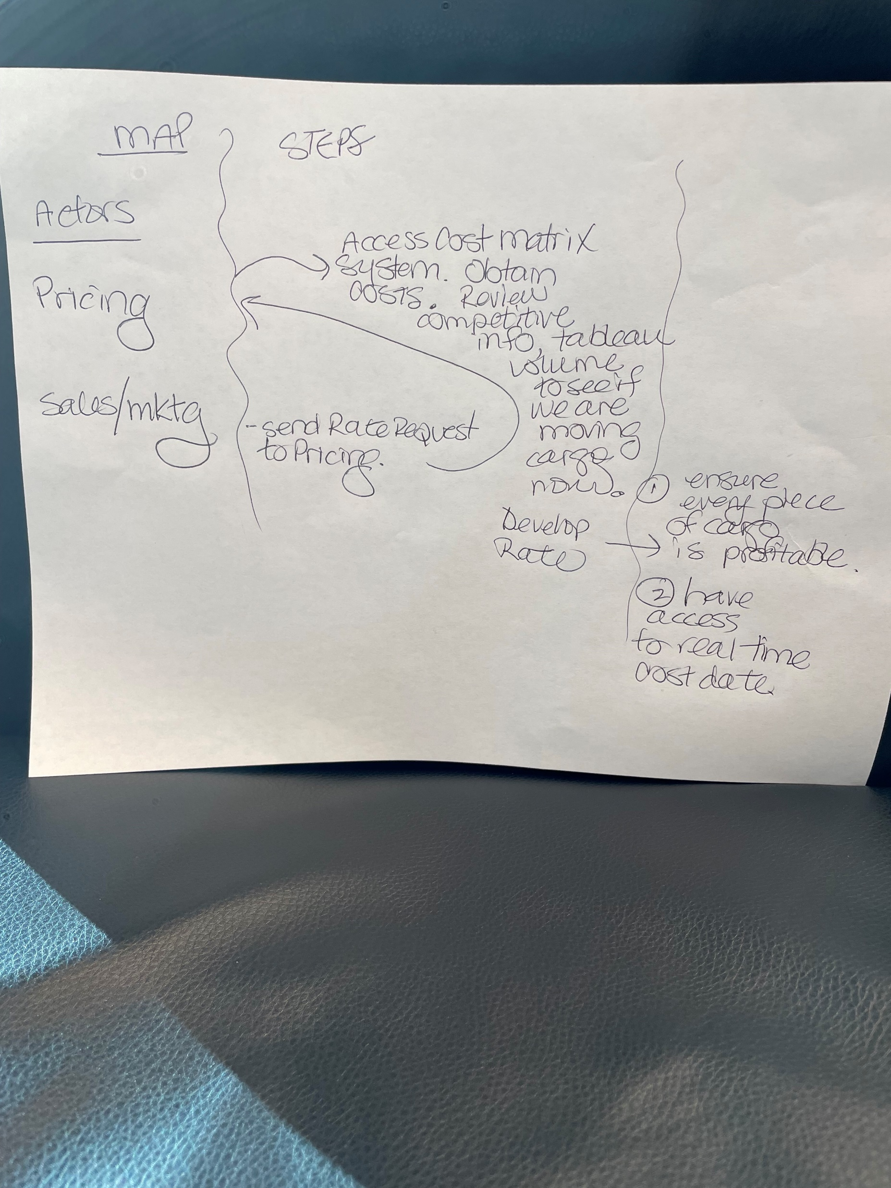

Slide 3
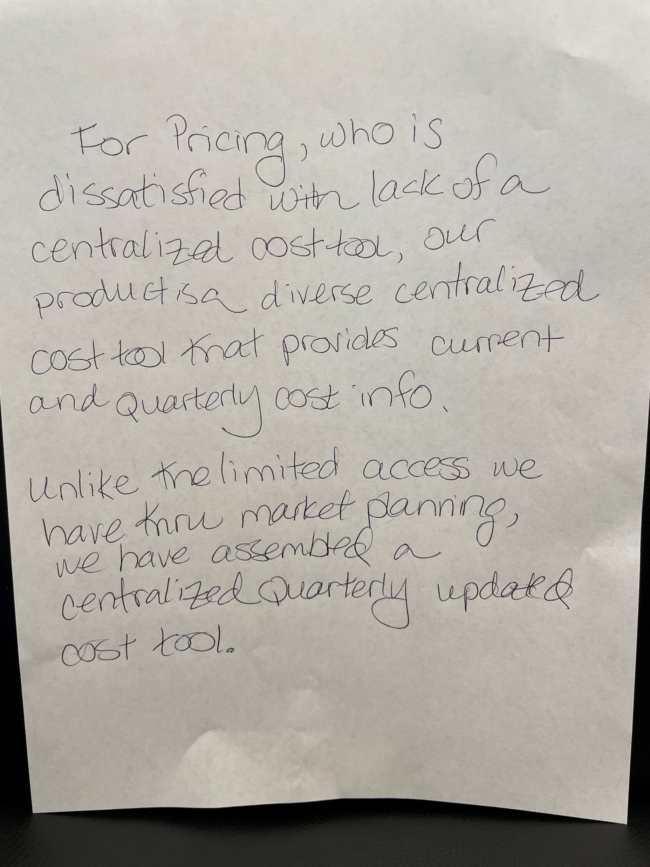

Slide 4
